Slide 1
Cibus Food Safety App

Slide 2
Cibus Caterings’ Mission…
To offer a simplified
Food Safety Solution for everyone

Slide 3
Problems with traditional Food Safety Systems…
Time Consuming
It takes on average 3-4 hours per week recording data
Human Error
Unreliability due to human error
Storage of Documents
Paperwork needs storing for up to 7 years

Slide 4
We have a digital solution for…
Task Management
Allowing you to view all daily tasks as they are required to be done
Reporting
Review and audit from anywhere
Food Act & OHS Compliance
Aligns with the New Zealand requirements

Slide 5
Our Core Principle…
A Professional Food Safety System that has reliability, functionality and ease of use

Slide 6
What are the benefits…
Value
42% cheaper than other systems on the market
Personal Approach
Your personalized system designed with your needs first
Time
Reminders, any device and audit ready anywhere
Storage
File management and Cloud storage

Slide 7
How it works…

Slide 8
Multiple Users…
Available Nationally
Accessible Worldwide

Slide 9
What can Cibus do for your business?
Save valuable time
Save money
Increase staff engagement
Simplify food safety for everyone
Be audit ready

Slide 10
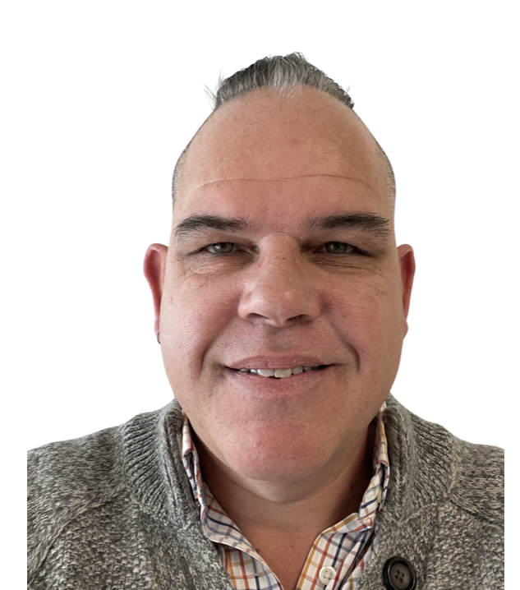
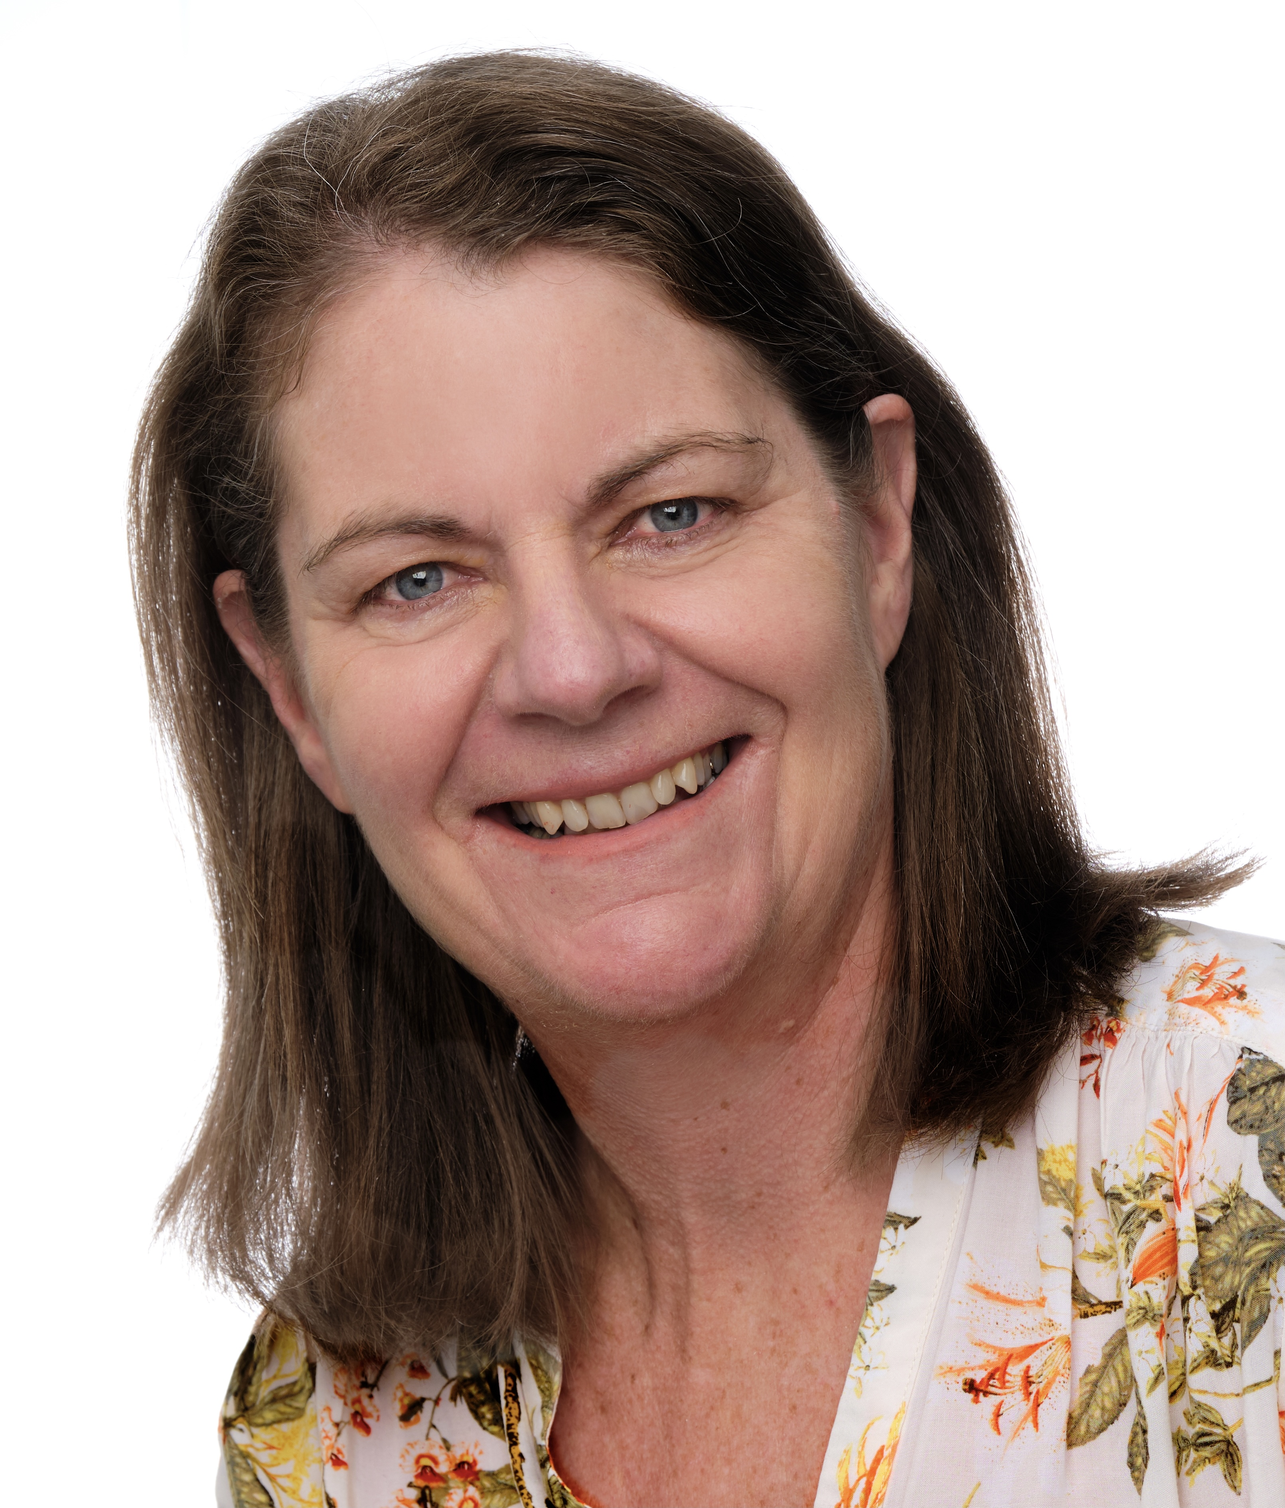
The Team
Peter Kennett
Managing Director
Julie Cooper
Director & Operations Manager
Robert Nicol
Kitchen Services

Slide 11
Contact Us
Phone: 021 987 103
Email: peter@cibuscatering.co.nz
Web: www.cibuscatering.co.nz

