Slide 1


New Look Cibus App

Slide 2
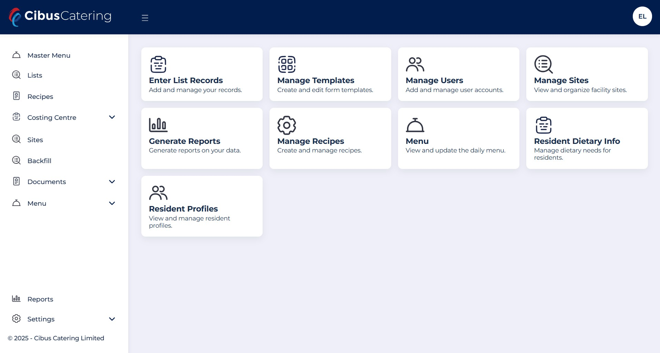
New home Page

Slide 3
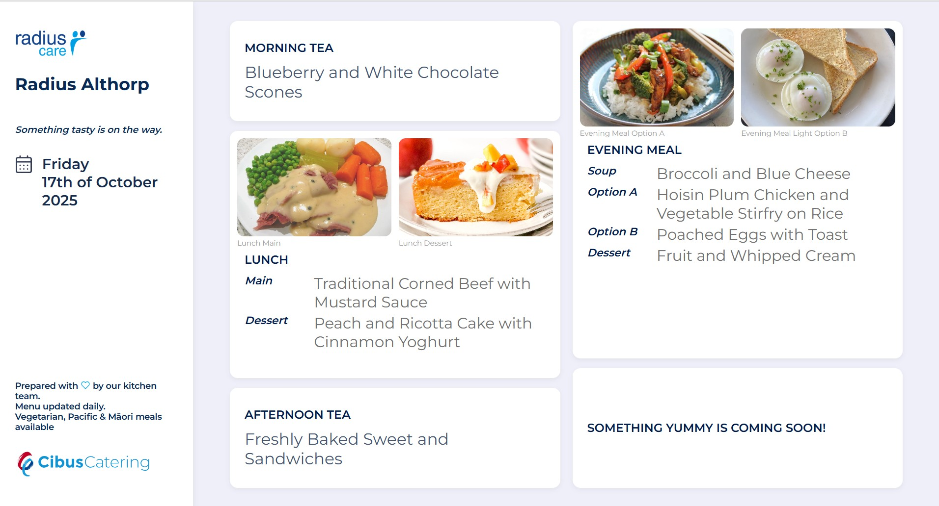
New Display menu

Slide 4
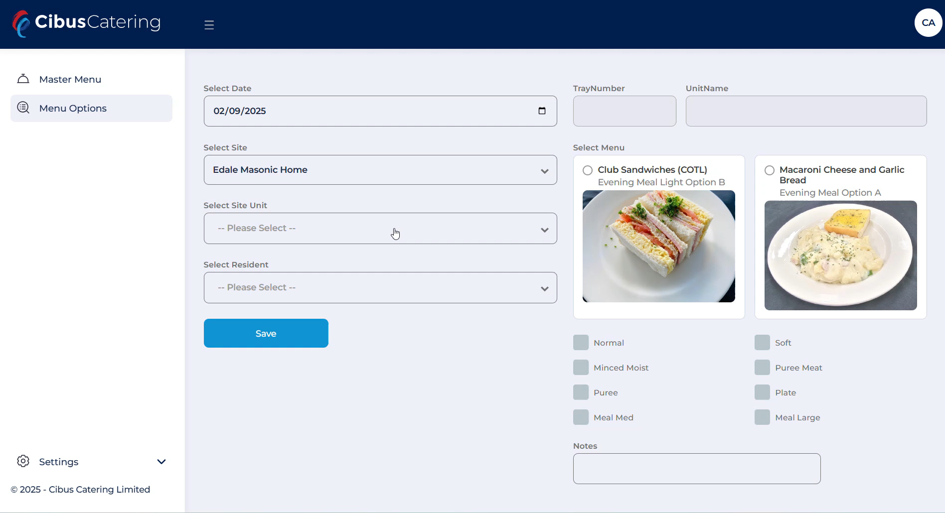
HCA Meal Choice Access

